Slide 1
CS4031 Compiler Construction Chapter 4
Faryal Saud
Lecturer, Department of Computer Science
FAST NUCES CFD

Slide 2
Practice: define the lex program for the given code lexems.
int main ( )
{
int x, a=2, b=3, c=5;
x = a+b*c;
printf(“the value of x is %d”, x);
return 0;
}

Slide 3
Practice: define the lex program for the given code lexems.
int main ( )
{
a = b + d;
int a, b, d;
printf(“sum of given is %d”; a);
}

Slide 4
Practice: define the lex program for the given code lexems.
int main ( )
{
a = b++++++===--;
}

Slide 5
Syntax Analysis
Syntax Analyzer creates the syntactic structure of the given source program.
This syntactic structure – parse tree.
Syntax analyzer is also known as parser
The syntax analyzer ( parser checked whether a given source program satisfies the rules of implied for context free grammar or not.
If it satisfies, the parser creates the parse tree of the program.
Otherwise the parser gives the error messages.

Slide 6
Syntax Trees
A syntax tree represents the syntactic structure of tokens in a program defined by the grammar of the programming language.
id1 = id2 + id3 * 60;

Slide 7
Front End Parser
Scanner
Tokens
Parser
IR
Source
Code
Errors

Slide 8
Front End Parser
Checks the stream of words and their parts of speech for grammatical correctness
Determines if the input is syntactically well formed
Guides context-sensitive (“semantic”) analysis (type checking)
Builds IR for source program

Slide 9
Syntactic Analysis
Natural language analogy: consider the sentence
He
wrote
the
program

Slide 10
Syntactic Analysis
Natural language analogy
He
wrote
the
program
noun
verb
article
noun
subject
predicate
object
sentence

Slide 11
Syntax Analysis in Programming Language
if
( b <= 0 )
a = b
bool expr
assignment
if-statement

Slide 12
Syntactic Analysis
int *compiler(int i, int j))
{
for(k = 0; i j;)
fi ( i > j)
return j;
}

Slide 13
Syntactic Analysis: Identify the error
Int *compiler(int i, int j))
{
for(k = 0; i j;)
fi ( i > j)
return j;
}
Extra Parenthesis
Missing Expression
Not a keyword

Slide 14
Semantic Analysis
int* compiler(int i, int j )
{
for(k=0; i<j; j++)
If( i < j – 2 )
float sum;
sum = sum + i;
return sum;
}

Slide 15
Role of Parser
Not all sequences of tokens are program.
Parser must distinguish between valid and invalid sequences of tokens.
What we need
An expressive way to describe the syntax
An acceptor mechanism that determines if input token stream satisfies the syntax

Slide 16
Study of Parsing
Parsing is the process of discovering a derivation for some sentence
Mathematical model of syntax – a grammar G.
Algortihm for testing membership in L(G).
Limitations of Regular Languages
Finite Automation can’t remember number of times it has visited a particular state

Slide 17
Grammar
Grammar is basically defined as a set of 4-tuple (V, T, P, S), where
V is set of nonterminals (variables),
T is set of terminals (primitive symbols),
P is set of productions (rules),
which govern the relationship between nonterminals and terminals, and S is start symbol with which strings in grammar are derived.

Slide 18
Terminal Symbols
Terminals symbols: these are represented by
Lower case letters of alphabet like a, c, z, etc.
Operator symbols like +, –, etc.
Punctuation symbols like ( , } , , etc.
Digits like 0…9, etc.
Bold face strings like int, main, if, else etc.

Slide 19
Non-Terminal Symbols
Nonterminal symbols: these are represented by
Upper case letters of alphabet like A, C, Z, etc.
Letter S is the start symbol.
Lower case strings like expr, stmt, etc.

Slide 20
Types of Grammar – Chomsky Hierarchy
The Chomsky hierarchy consists of four levels, which are
Type 0 (unrestricted),
Type 1 (context-sensitive),
Type 2 (context-free),
Type 3 (regular)
The levels are based on the complexity of the formal grammar needed to generate a language.

Slide 21
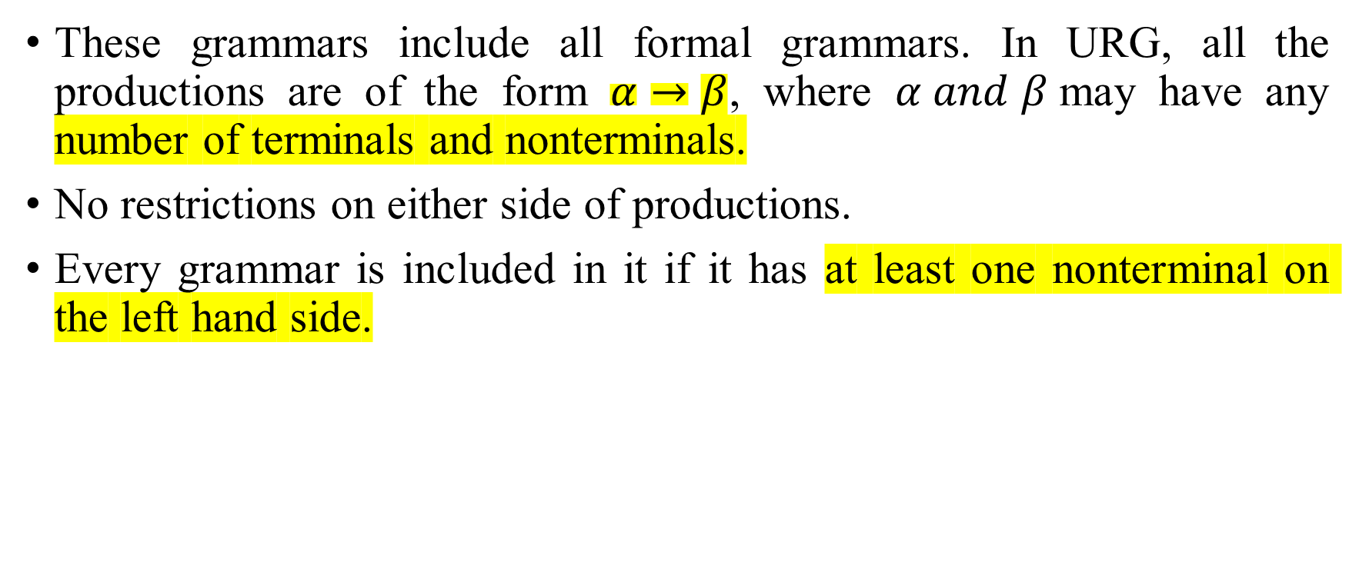
Type 0 Grammar
These grammars include all formal grammars. In URG, all the productions are of the form $α→β$, where $α and β$may have any number of terminals and nonterminals.
No restrictions on either side of productions.
Every grammar is included in it if it has at least one nonterminal on the left hand side.

Slide 22
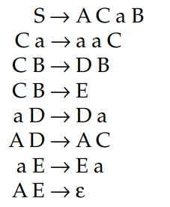

Example:
The language specified by L(G) = {$a^{2i}$| i > = 1} is an unrestricted grammar. This grammar is also called phrase structured grammar.
The grammar is represented by the following productions:

Slide 23
Type 1 Grammar: Context Sensitive grammar
These grammars define the context sensitive languages. In CSG, all the productions of the form α → β where |α| ≤ | β|, α and β may have any number of terminals and non terminals.
These grammars can have rules of the form αAβ → αγβ with A as nonterminal and α, β and γ are strings of terminals and non terminals.
We can replace A by γ, where A lies between α and β. Hence, the name context sensitive grammar. The strings α and β may be empty, but γ must be nonempty.

Slide 24
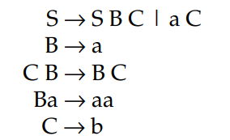

Example
The language specified by L(G) = {$a^{n}b^{n}$| n > = 1} is a context sensitive grammar.

Slide 25
Type 2 Grammar: Context Free Grammar
These grammars define the context free languages. These are defined by rules of the form α → β with |α| ≤ | β where |α| = 1 and is a nonterminal and β is a string of terminals and non terminals.
We can replace α by β regardless of where it appears.

Slide 26


Example:
The language specified by L(G) = {$a^{n}b^{n}$| n > = 1} is a context sensitive grammar.

Slide 27
Type 3 Grammar: Regular Grammar
These grammars generate the regular languages. Such a grammar restricts its rules to a single nonterminal on the left hand side.
The right hand side consists of either a single terminal or a string of terminals with a single nonterminal on the left or the right end. Here rules can be of the form A → a B | a or A → Ba | a.

Slide 28
Example:
Right linear grammar: A → a A | a
Left linear grammar: A → A a | a

Slide 29
Backus-Naur Form (BNF)
BNF stands for Backus-Naur Form. It is used to write a formal representation of a context-free grammar. It is also used to describe the syntax of a programming language.
BNF stands for Backus-Naur Form. It is used to write a formal representation of a context-free grammar. It is also used to describe the syntax of a programming language.
BNF uses a range of symbols and expressions to create production rules. A simple BNF production rule might look like this:
<digit> ::= 0|1|2|3|4|5|6|7|8|9

Slide 30
BNF
It is a formal mathematical way to describe a language
It is used describe the syntax of programming language
It consists of
A set of terminal symbols
A set of non-terminal symbols
A set of production rules of the form
Left-hand-side ::= right-hand-side
The meaning of the production rule is that the non-terminal on the LHS may be replaced by the expression on the RHS.

Slide 31

Example
Let us use the expression grammar to derive the sentence
$$x−2 ∗y$$

Slide 32
Solution
<expression> ::= <term> | <expression> “-” <term>
<term> ::= <factor> | <term> “*” <factor>
<factor> ::= “x” | “y” | <number>
<number> ::= “2”

Slide 33
Left Most Derivation
G
E
E
op
E
x
–
op
E
E
2
*
y

Slide 34
Right Most Derivation
G
E
E
op
E
E
op
E
*
y
x
–
2

Slide 35
Basic Points
Left Factoring
Left Recursion
Right Recursion
Left Most Derivation
Right Most Derivation

Slide 36
Parsing Technique
Parser
Top-Down Parser
Recursive Descent Parser
LL(1) Parser
Bottom-Up Parser
LR Parser
Operator Precedence Operator
LL(0)
SLR(1)
LALR(1)
CLR(1)
Notes:
LL1 parser is also known as predictive parser

Slide 37
Top Down Parser
In top down parser we have two types of parser
Recursive Descent
LL(1) Parser
First L represent the direction of look a head pointer.
L represent the type of derivation.
1 means how many symbol we read from the string.
LL means we used left to right derivation and making the left most derivation tree.

